Slide 1
Assignments class 6

Slide 2
Assignment 1
The government of country “X” reduces the income tax rate.
Determine whether the event shifts AD or AS.
Determine whether curve shifts left or right.
Use AD-AS diagram to see how the shift changes Y and P in the short run.

Slide 3
Assignment 2
The government of country “Y” introduces an environmental tax. Each company will have to pay this environmental tax, that is calculated as a percentage of the total production costs.
Determine whether the event shifts AD or AS.
Determine whether curve shifts left or right.
Use AD-AS diagram to see how the shift changes Y and P in the short run.
Determine whether there is demand-pull inflation or cost push inflation

Slide 4
Assignment 3
The government of Curacao is currently conducting a major upgrading of the road infrastructure. Use the AD and SRAS diagram to analyse how the investment by the government in the road infrastructure affects the economy.
Determine whether the event shifts AD or AS.
Determine whether curve shifts left or right. Right
Use AD-AS diagram to see how the shift changes Y and P in the short run.
Determine whether there is demand-pull inflation or cost-push inflation

Slide 5
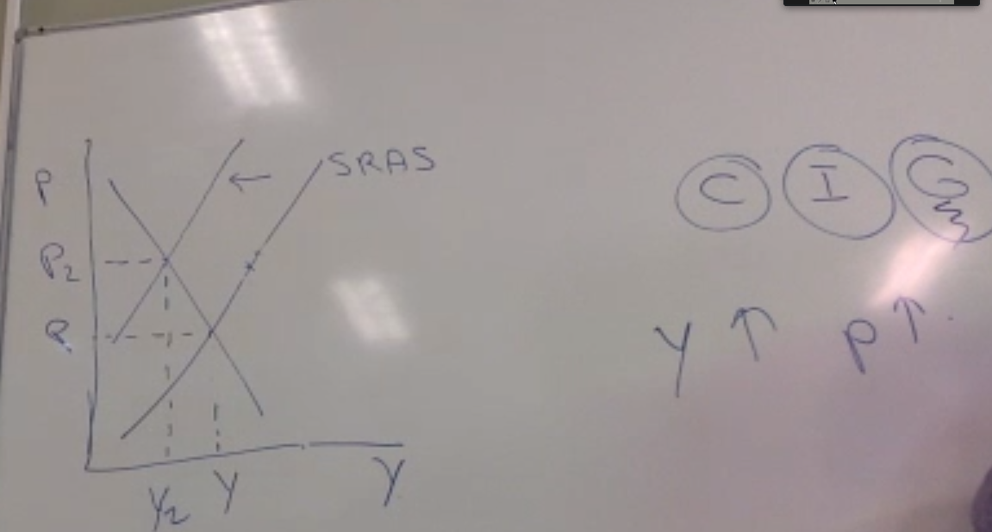

Slide 6
Assignment 4
Use the AD and SRAS diagram to analyse how an improvement of business confidence affects the economy.
Determine whether the event shifts AD or AS.
Determine whether curve shifts left or right. Right
Use AD-AS diagram to see how the shift changes Y and P in the short run.
Determine whether there is demand-pull inflation or cost-push inflation

Slide 7
Assignment 5
Use the AD and SRAS diagram to analyse how a general strike in Curacao will affect GDP and inflation on the short run.
Determine whether the event shifts AD or AS.
Determine whether curve shifts left or right.
Use AD-AS diagram to see how the shift changes Y and P in the short run.
Determine whether there is demand-pull inflation or cost-push inflation

